Slide 1





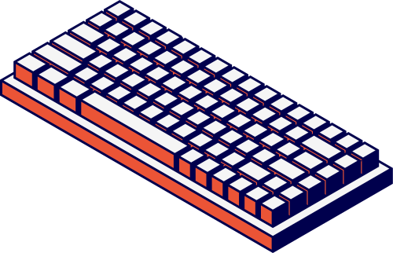
Rile Vince W. Soledad
Hezekiah C. Gatela
Computer
Science 2
The
Program
Start

Slide 2

Rile Vince W. Soledad
Hezekiah C. Gatela
Welcome!
to the Fresh Tracker! Team
Members:
Hezekiah C. Gatela (Interface, if statements)
Rile Vince W. Soledad (day logic)

Slide 3

Rile Vince W. Soledad
Hezekiah C. Gatela
Introduction / Problem Statement
Fresh Tracker!
– A Grocery and Expiry Date Management Tool
In many households, food and household products are often forgotten in storage until they expire,
leading to waste and unnecessary expenses. Likewise, grocery shopping can be unorganized, resulting
in overspending, buying duplicates, or forgetting essential items. Additionally, calculating expenses with
discounts, vouchers, and coupons can be confusing and time-consuming.
This project addresses the problem of product waste, poor grocery organization, and budgeting
challenges by creating a tool that helps users track expiry dates, manage grocery lists, and compute
costs effectively

Slide 4

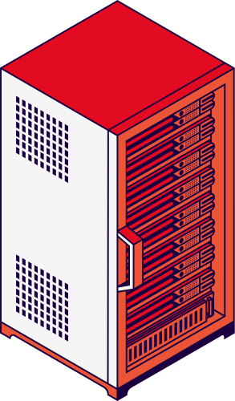
Rile Vince W. Soledad
Hezekiah C. Gatela
Our
Objectives
1. To provide a reminder system for expiry dates, reducing wasted food and money.
2. To organize grocery shopping through an interactive list where users can add, remove, and check
items.
3. To calculate total expenses including discounts, vouchers, and coupons for better budgeting.
4. To implement Python programming concepts (lists, conditional statements, functions, input/output).
5. To encourage responsible consumption and effective household management.

Slide 5


Rile Vince W. Soledad
Hezekiah C. Gatela
Our
Features
1. Expiry Tracker – Keeps track of items that are about to expire.
2. Grocery List Manager – Add, remove, and check products as bought.
3. Cost Calculator – Computes expenses and applies discounts/coupons.

Slide 6


Rile Vince W. Soledad
Hezekiah C. Gatela
Inputs and Outputs:
Inputs:
- Product name
- Expiry date (manual entry) OR product type (to assign estimated expiry)
- Grocery list items
- Item prices, vouchers, or coupon values
- User choices (menu navigation)
Outputs:
- Alerts for expiring items (manual or estimated expiry)
- Organized grocery list (add/remove/check items)
- Total cost calculation (with applied discounts)
- Confirmation messages (e.g., “Removed Soy Sauce!”)
- Closing message: “Thank you for using Fresh Tracker! May all your food BE FRESH!”

Slide 7

START PROGRAM
DISPLAY main menu
1 - Expiry Date Tracker
2 - Grocery List
3 - Calculator
IF user chooses 1:
ASK for product name
ASK if expiry date is provided
IF yes:
STORE entered date
IF no:
LOOK UP estimated shelf life (e.g., banana = 21 days)
CALCULATE expiry = today + shelf life
STORE estimated date
CHECK if product is near expiry
IF true, DISPLAY alert
IF user chooses 2:
DISPLAY grocery list options:
1 - Add Product
2 - Remove Product
UPDATE grocery list accordingly
DISPLAY updated list
IF user chooses 3:
ASK for item prices
ASK for vouchers/coupons
CALCULATE total cost
DISPLAY final cost
ASK user if they want to return to home
IF yes ® GO BACK to main menu
IF no ® DISPLAY exit message
END PROGRAM
Rile Vince W. Soledad
Hezekiah C. Gatela
Pseudocode
Get Started

Slide 8
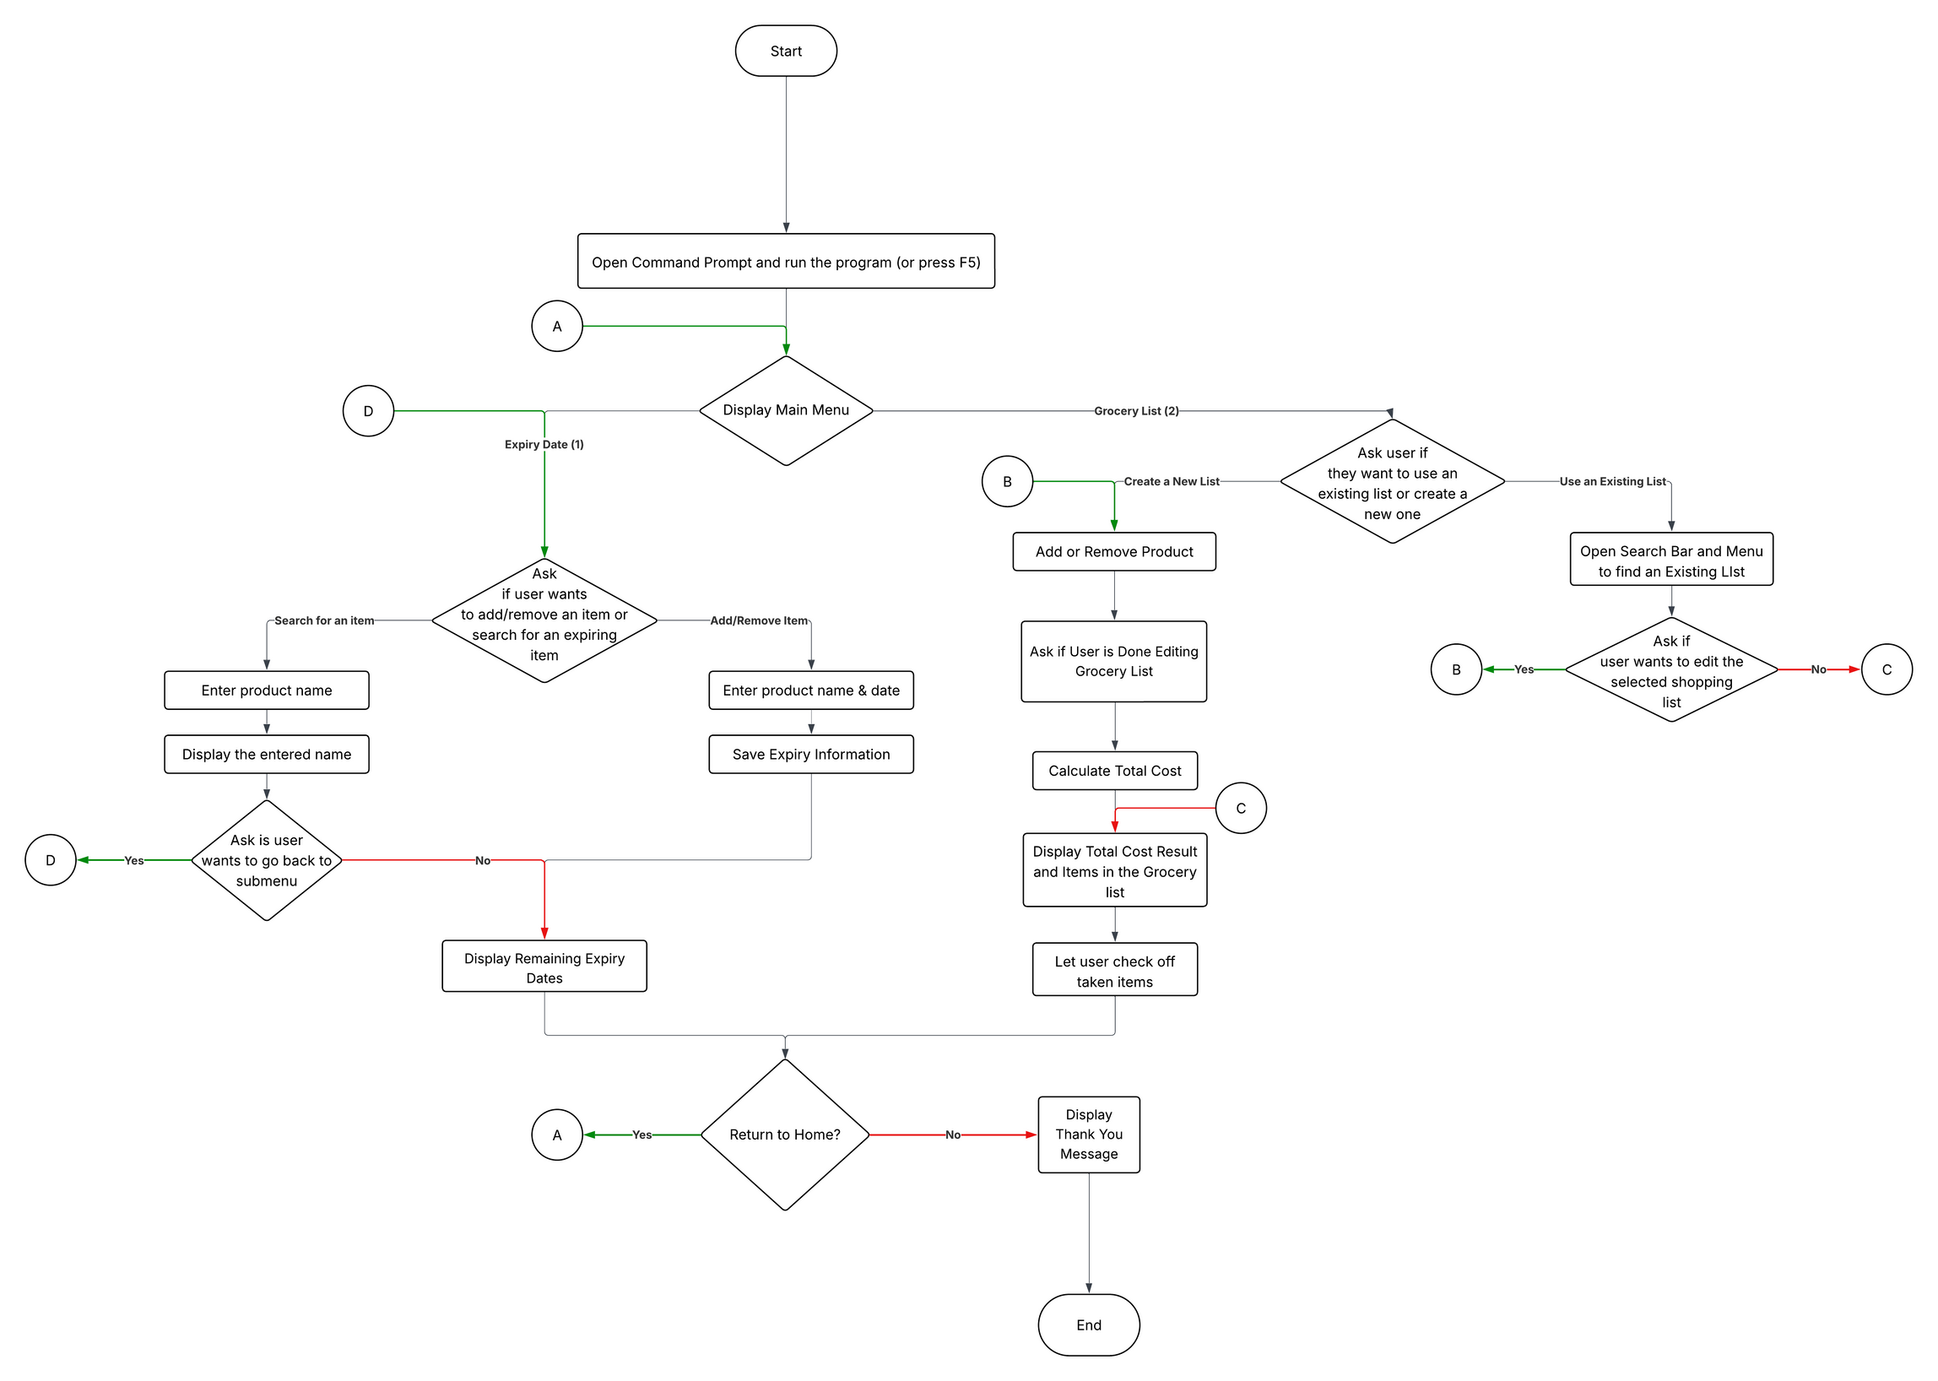

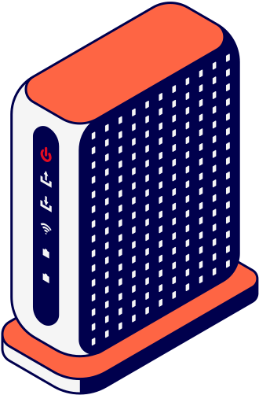
Flowchart
Rile Vince W. Soledad
Hezekiah C. Gatela

Slide 9
The
End

Slide 10
Rile Vince W. Soledad
Hezekiah C. Gatela
Thank You!
from the Fresh Tracker! Team
Members:
Hezekiah C. Gatela (Interface, if statements)
Rile Vince W. Soledad (day logic)
The
Program

